Slide 1

Electricity Billing System
A desktop application designed to streamline electricity billing. It focuses on calculating consumed units and charges. The system aims to be easy, accessible, and effective for consumers.

Slide 2
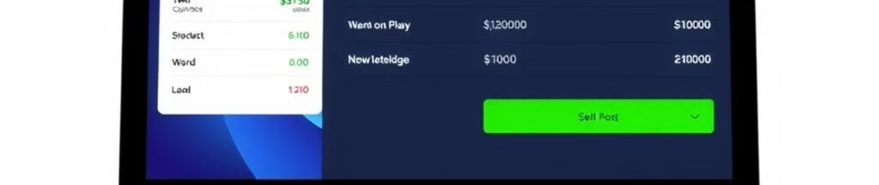
Introduction
1
Computerized Billing
2
Unit Calculation
3
Customer Satisfaction
Aims to computerize the billing system.
Focuses on calculating units consumed.
Saves time and maintains records.

Slide 3

Project Objectives
Energy Information
Customer Data
Bill Generation
Track current and previous month unit consumption.
Maintain customer information.
Generate bills with penalties and rent.

Slide 4
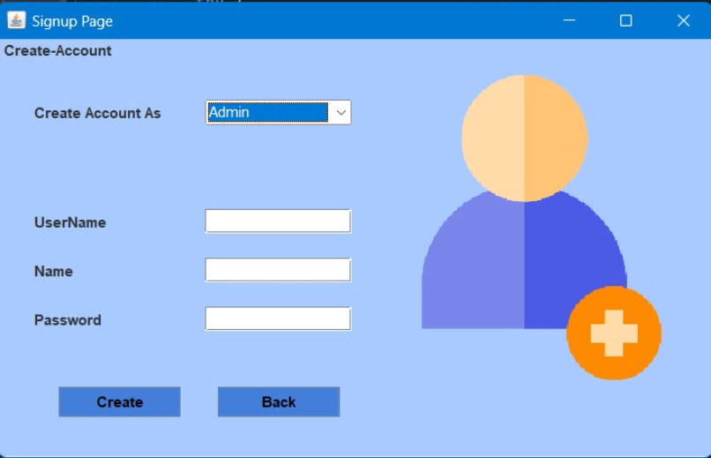
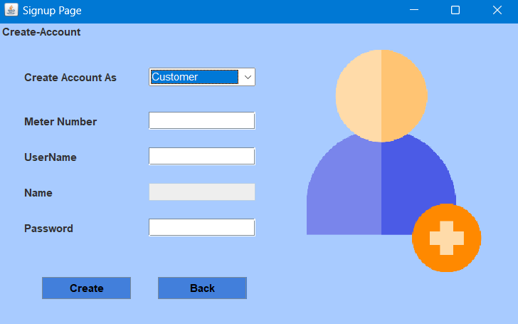
Sign Up
New Accounts
Customer Details
Admin Details
New customers/admins can sign up.
Enter meter-no, username, name, password.
Enter username, name, password.

Slide 5
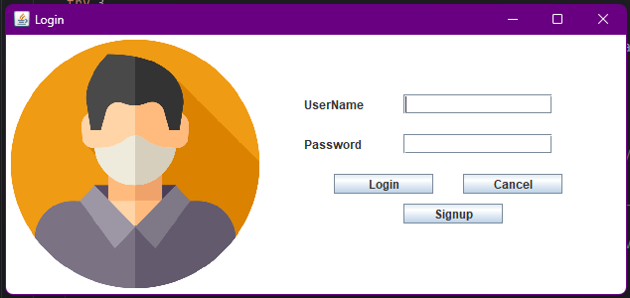


Login
Account Access
Customers and admins can log in.
User Role Identification
The system automatically identifies whether
the user is an Admin or a Customer
based on the credentials.

Slide 6

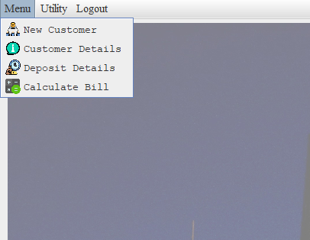
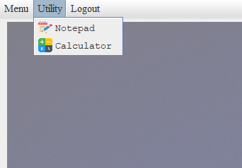
Admin Home Screen
1
Menu Section
New Customer,
Customer Details, Calculate Bill.
2
Utility Section
Notepad, Calculator.
3
Exit
Logout option.

Slide 7
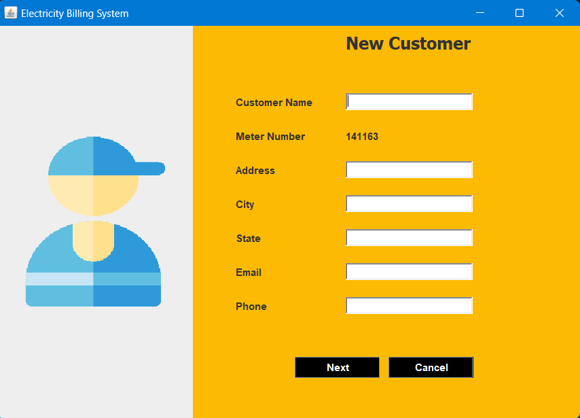
New Customer
Customer Details
1
Admin enters customer details.
Meter Number
2
System generates unique meter number.

Slide 8
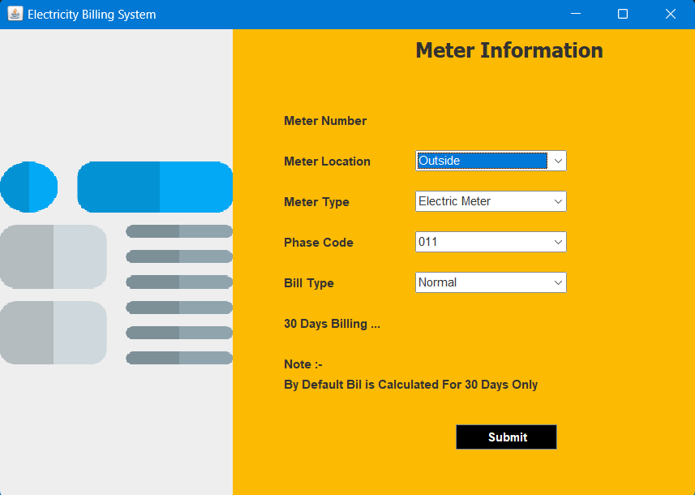



Meter
Information
Bill Type
Location
Residential or Commercial/Industrial.
Admin selects meter location.
Meter Type
Admin selects meter type.

Slide 9
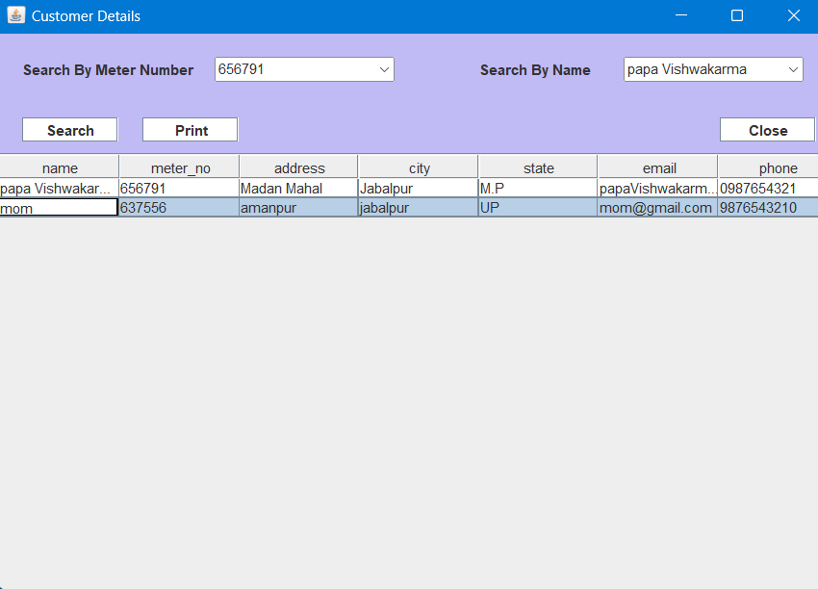
Customer Details
1
View Details
2
Print Option

Slide 10

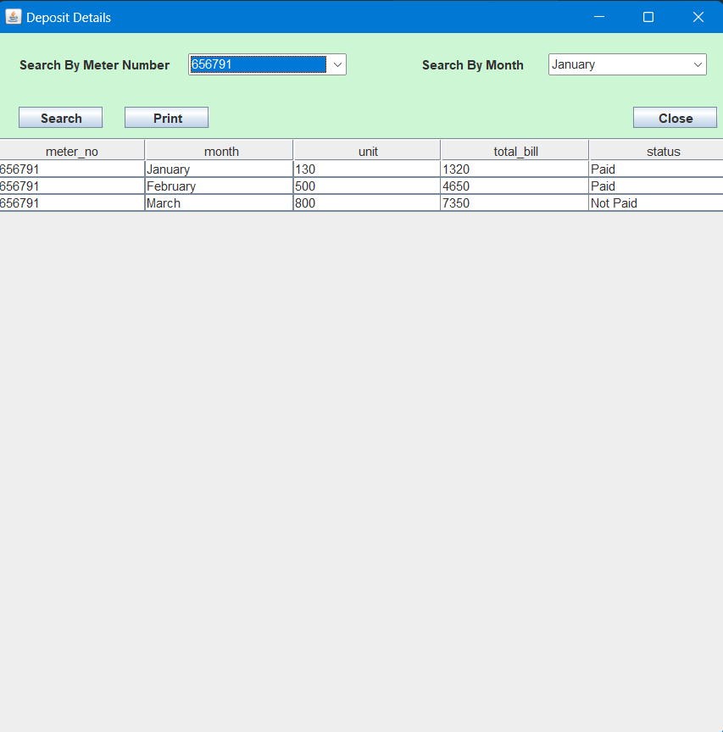



Deposit Details
1
View Bill Details
2
Sort Details
3
Search Option
4
Print Option

Slide 11
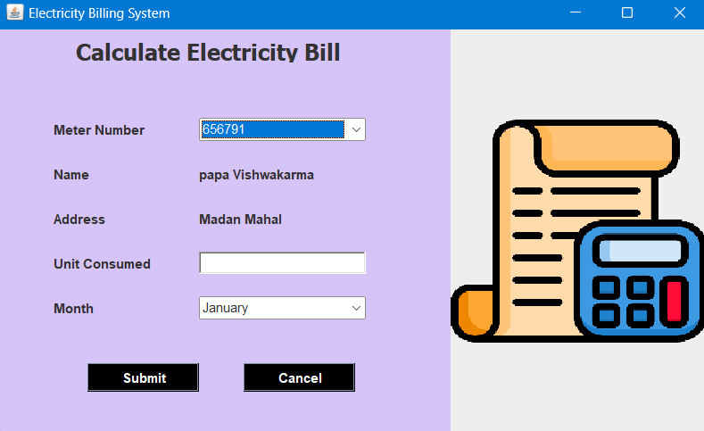
Calculate Bill
This program calculates total bill. It uses units consumed,
meter number, and month. Submit tax details by clicking
submit. Cancel entered details with the cancel option.

Slide 12
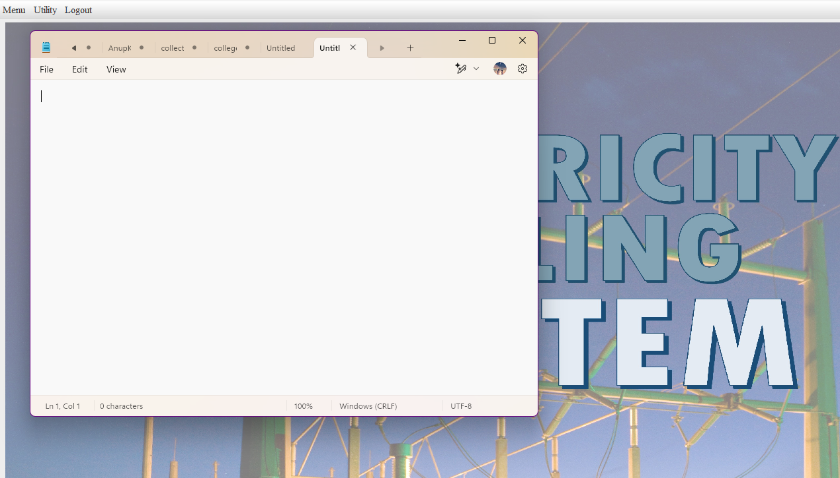
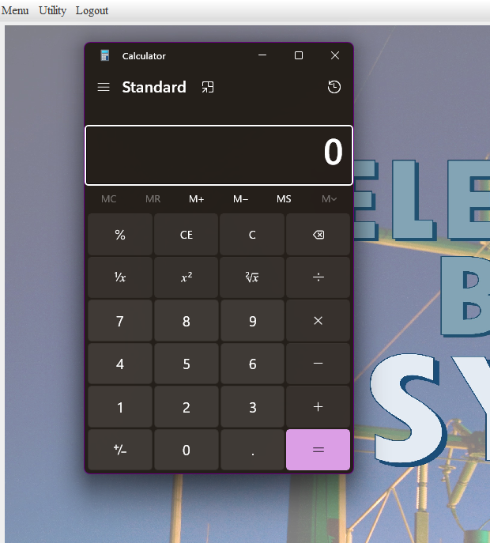
Utilities: Notepad & Calculator
Notepad
Calculator
Launches when the user clicks on the notepad option.
Launches when the user clicks on the calculator option.
Available to both Admins and Customers

Slide 13
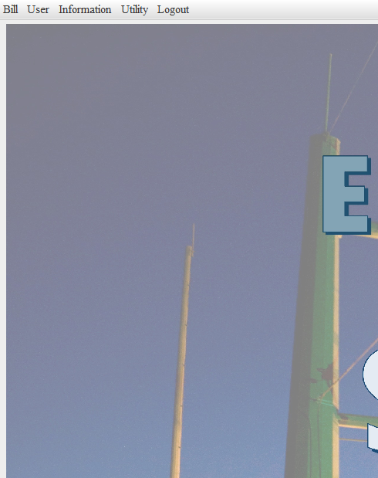
Customer Page
Pay Bill
Bill Details
Generate Bill Slip
Update Information
Customer lands here after login. It contains sections for bills, info, and utilities.

Slide 14
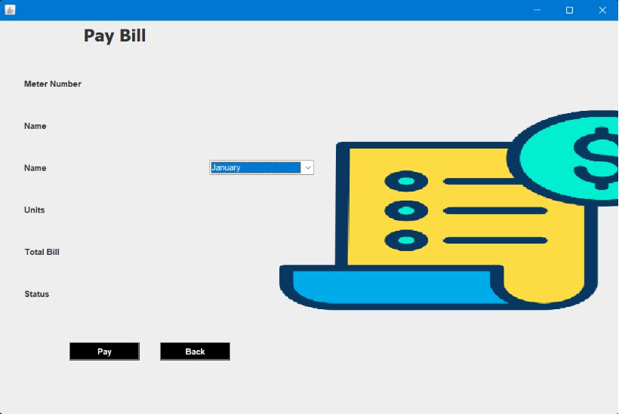
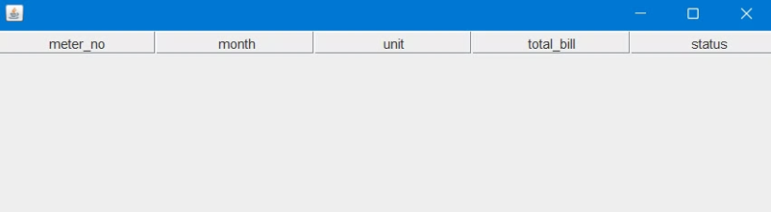
Bill Payment & Details
Pay Bill
Bill Details
Customers pay bills by selecting the appropriate month.
Customers check their bill status: paid or unpaid.

Slide 15

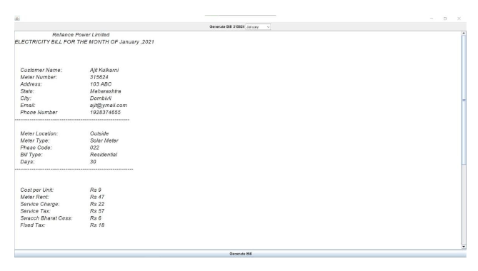

Generate Bill Slip
View Breakdown
Customers can generate and view their bill.
Amount
See a proper breakdown of the entire amount.

Slide 16
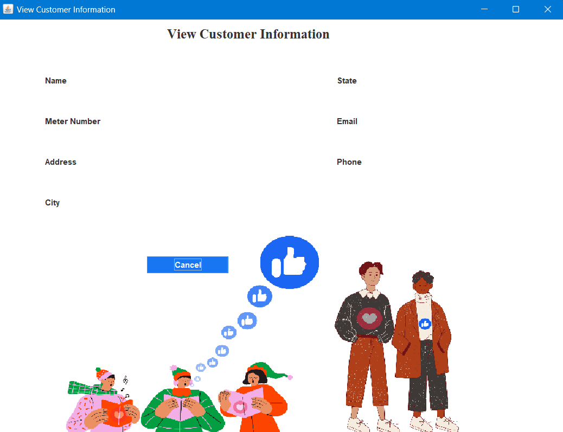
View Information
1
Personal Details
Name, meter number, address, city, state.
2
Contact Details
Email ID and phone number.
Customers can see their entered information.

Slide 17
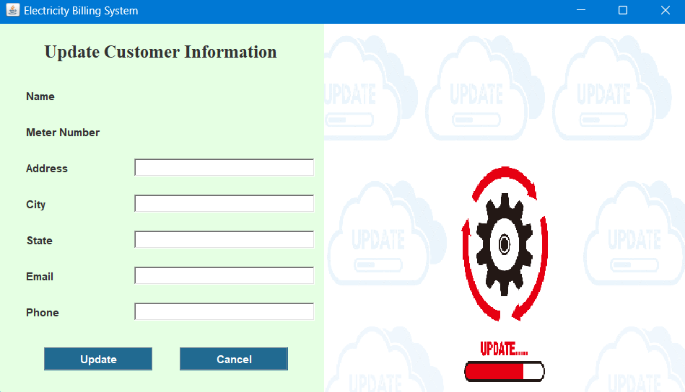
Update Information
1
Address
2
Contact
3
Email
Customers can update their information if needed.

Slide 18




Conclusion
Billing
Efficiency
Friendly UI
Helps manage billing cycles.
Reduces manual data entry.
Easy to use interface.
This software helps users with billing, paying bills, and managing details.

